Slide 1

Tranexamic acid for the prevention of postpartum bleeding in women with moderate and severe anaemia: an international, randomised, double-blind, placebo-controlled trial The WOMAN-2 Trial Collaborators

Slide 2
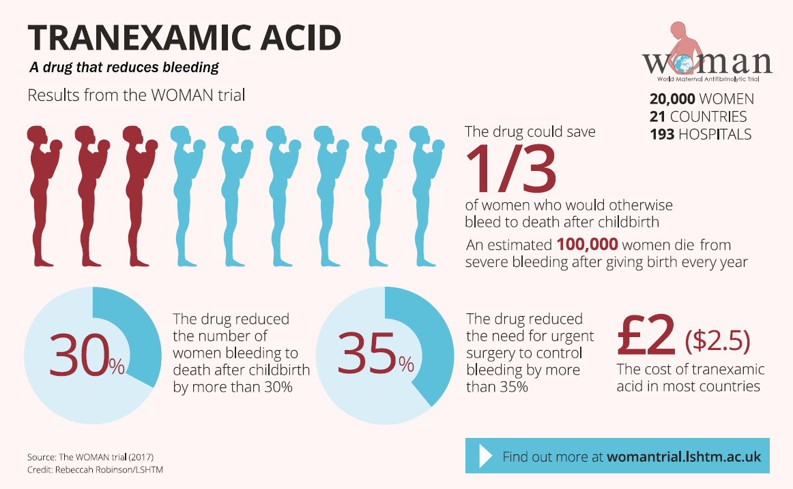

Slide 3
For some women treatment is too late
Bleeding
Other
Number of deaths
Hours since randomisation
The WOMAN Trial Collaborators. Lancet. 2017 ; 389 (10084): 2105-16.
Notes:
Most PPH deaths occur in the first few hours after giving birth

Slide 4

Why WOMAN-2?
“Our women are different.”
Professor Bukola Fawole (1960-2019)

Slide 5
The WOMAN-2 Trial
Aim
To determine the effect of TXA on postpartum bleeding in women with moderate or severe anaemia
Trial design
Randomised, double-blind, placebo-controlled trial
15 000 women with moderate or severe anaemia who are giving birth vaginally in hospitals
Randomised to receive 1 g of TXA or matching placebo (sodium chloride 0.9%) intravenously immediately and no later than 15 minutes after the umbilical cord is cut or clamped
Inclusion criteria
Women with moderate or severe anaemia (Hb level <100 g/L or PCV <30%), who have given birth vaginally and for who the responsible clinician is substantially uncertain whether to use TXA

Slide 6
The WOMAN-2 Trial
Exclusion criteria
Women who are not legally adult (<18 years) and permission not provided by a guardian
Women with a known allergy to TXA or its excipients
Women who develop PPH before umbilical cord is clamped/cut
Follow-up
Outcomes related to PPH collected at 24 hours, discharge, or death, whichever occurred first
Other outcomes collected at day 42, discharge, or death, whichever occurred first
Adverse events were monitored for up to 42 days after randomisation

Slide 7
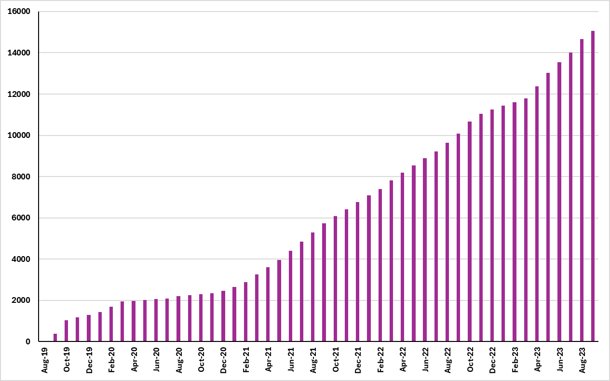
Participant enrolment

Slide 8
Participant enrolment
15, 068 participants randomised in Nigeria, Pakistan, Tanzania and Zambia
COUNTRY | RANDOMISED
Nigeria | 1 326
Pakistan | 11 025
Tanzania | 2 029
Zambia | 688
TRIAL | 15 068

Slide 9
Trial profile
Randomised (n= 15,068)
Allocated to TXA (n=7580)
Received allocated intervention (n=7580)
Analysed for primary outcome (n=7487)
Analysed for primary outcome (n=7579)
Allocated to placebo (n=7488)
Received allocated intervention (n=7488)
No Follow-up (n=1) ª
Trial treatment fully given(n=7579)
Trial treatment not fully given(n= 1)
No Follow-up (n=1) ª
Trial treatment fully given(n=7482)
Trial treatment not fully given(n=6 )
Assessed for eligibility
(n= 16,586)
Excluded (n=1,518 )
- Not meeting inclusion criteria (n=1345)
- Declined to participate (n=13 )
- Other reasons (n= 160)
ENROLMENT
ALLOCATION
FOLLOW-UP
ANALYSIS
ª = Patients for whom there is no information about the primary endpoint.

Slide 10
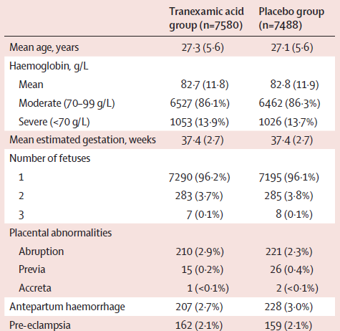
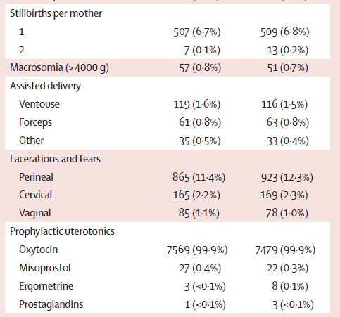
Baseline characteristics

Slide 11
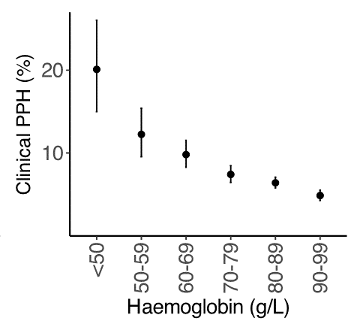
Baseline characteristics by maternal haemoglobin concentration

Slide 12
Women with anaemia bleed faster and decompensate sooner

Slide 13
TXA in women with moderate & severe anaemia
Outcome is clinically diagnosed postpartum haemorrhage
Lancet 2024; 404: 1645-56
Notes:
In women with moderate and severe anaemia, giving tranexamic acid within 15 min of the umbilical cord being clamped did not reduce the risk of clinically diagnosed postpartum haemorrhage.

Slide 14
TXA in women with moderate & severe anaemia
 | Tranexamic acid (n=7579) | Placebo (n=7487) | RR | 95% CI | p value
Estimated blood loss (ml)
Mean(SD) | 309∙8 (193∙9) | 310∙8 (191∙5) | -0∙95 | (-7∙10-5∙21) | 0∙76
Haemoglobin* (g/L)
Mean(SD) | 82∙2 (15∙5) | 82∙1 (15∙7) | 0∙12 | (-0∙26-0∙50) | 0∙54
Vascular occlusive event**
Any event | 0 | 0
Death or near miss death***
Any death or near miss | 122 (1∙6%) | 137 (1∙8%) | 0∙88 | (0∙69-1∙12) | 0∙30
*corrected for the effect of blood transfusion
**pulmonary embolism, deep vein thrombosis, stroke and myocardial infarction
***Death from any cause or near-miss death from PPH. Near miss death for PPH is defined by the WHO as severe PPH (blood loss of 1000ml+), surgical intervention for bleeding (hysterectomy for bleeding, laparotomy, embolization, uterine compression sutures, arterial ligation), failure to form clots, transfusion of >5 units, cardiovascular dysfunction (shock, cardiac arrest, continuous vasoactive drugs, severe hypoperfusion, severe acidosis, CPR), renal dysfunction diagnosed ( oliguria non-responsive to fluids or diuretics, dialysis for acute renal failure, severe acute azotemia)
Notes:
There were no adverse events related to the treatment and no treatment-related deaths.

Slide 15
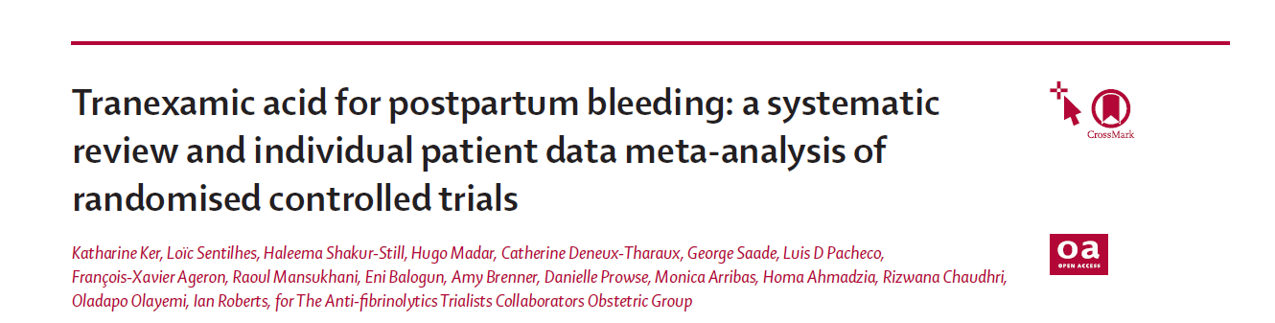
Effect of TXA on life-threatening bleeding
Lancet 2024; 404: 1657–67
Notes:
We also conducted a Systematic review and IPD meta-analysis to assess the effect of tranexamic acid on life-threatening bleeding and thrombosis.
Individual patient data from high-quality trials involving at least 500 women.
The analysis included data from 54 404 women from five high-quality trials of tranexamic acid:
WOMAN and WOMAN-2 Trials, which recruited in low- and middle-income countries
TRAAP, TRAAP-2 and TXA-MFMU trials, which recruited women in high-income countries (France or USA)
The results have also been published in the Lancet Journal

Slide 16
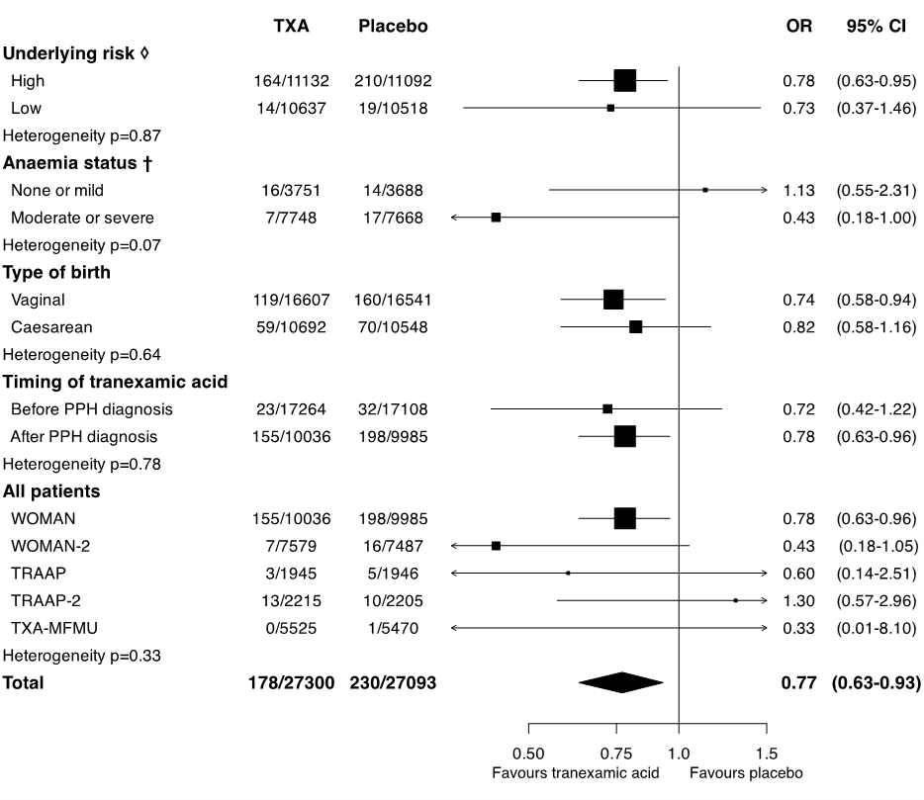
Effect of TXA on life-threatening bleeding*
; p=0.008
*death or surgical intervention for bleeding (laparotomy, embolization, uterine compression sutures, or arterial ligation) within 24 hours after birth.
Notes:
The analysis showed that:
Tranexamic acid reduced life-threatening bleeding in women giving birth, regardless of the underlying risk, the type of birth, the presence of moderate or severe anaemia, or whether a diagnosis of postpartum haemorrhage had been made.

Slide 17
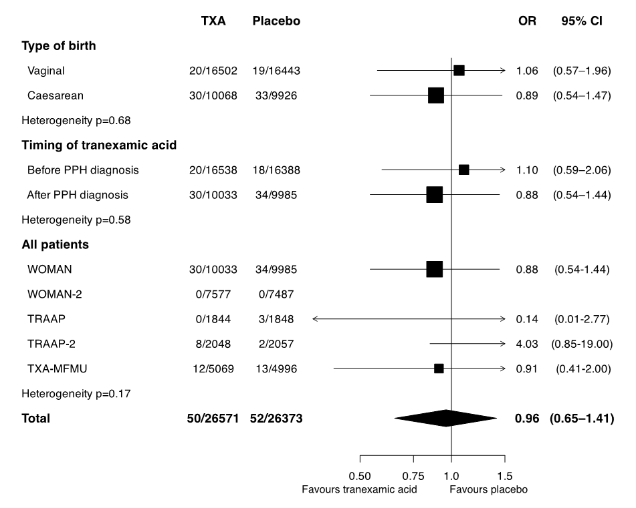
Effect of TXA on fatal or non-fatal thromboembolic events
; p=0.82
Notes:
There was no evidence that tranexamic acid increases the risk of thrombosis.
Clinicians should consider giving tranexamic acid to women at high risk of death, before a diagnosis of postpartum haemorrhage is made.

Slide 18
Implications for obstetric care
Tranexamic acid did not prevent clinically diagnosed postpartum haemorrhage in women with moderate or severe anaemia
No evidence of adverse effects
Anaemia is a strong risk factor for life-threatening bleeding after birth. So, we must prevent and treat anaemia in women of childbearing age.
There is strong evidence that TXA reduces life-threatening bleeding. We must make sure that TXA is available for all women who need it.

Slide 19


Funded by:

Slide 20
woman2@Lshtm.ac.uk
woman2.Lshtm.ac.uk
https://www.lshtm.ac.uk/research/centres-projects-groups/the-woman-trials

